Slide 1
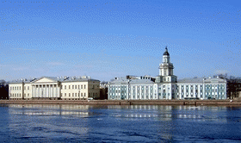
Three Adrienne years from Russian side of partnership:
Marina Orlova et al.
SPBRC RAS, Project Partner-2
ER55 Final seminar
March, 2022

Slide 2
Briefly on what the ER55 was for us:
This was scientific co-operation has been lasted for 3 years and accompanied with additional positive side effects.
Intensive and extensive fieldwork aimed to get data with certain resolution – the first experience in Russian side of EGOF space.
The project and current situation has encouraged to establish own geinformational space (portal) in SPbRC RAS («Наследие, Город, Человек и Природа») including thematic division “Man and Nature” based of ER55’s conceptual ideas and rissian data collected for 2019-2022
Development of outputs has continued the earlier Cross-border co-operative efforts (TOPCONS, ENPI CBC, Russia-South-east Finland)
New findings and scientific data = underpinning to ecosystem structure and functioning and its change over time and under various driving forces– central point of the project!
It was new experience in contribution to our future – videos for two young age categories of common peoples and educational community
2

Slide 3
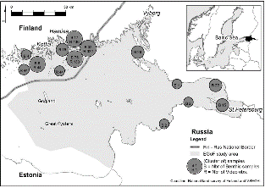
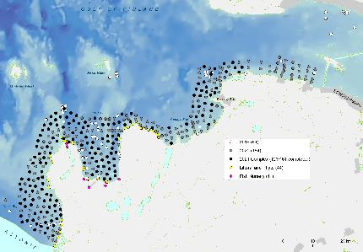
The fieldwork for landscape mapping and modelling (from Kaskela et al., 2017 till September 2021)
was
achieved
Quantitative samples only: from highly aggregated sampling to “resolution-based” sampling, accompanied with photo and videodocumenting
3

Slide 4

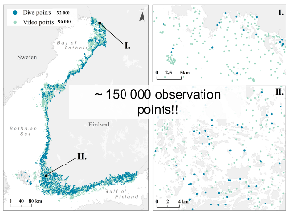

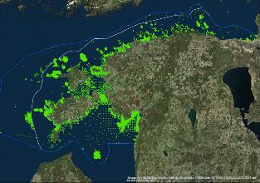
RU
FI
EST
Observation point with benthos sampling (1-4 sample per point) 2019-2021 – totally ~ 450; resolution ca 2000 m.
2012-2014 – 72 observation points; resolution up to 50000m between subareas
TOPCONS 2012-2014
4

Slide 5
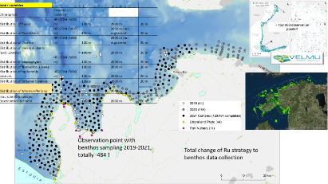


Core constituent of results – data obtained from extensive targeted fieldwork
Data obtained from targeted fieldwork during the project lasts and before, combined with environmental information (description and measurements), remote sensing data (visualization of sea uses)
Files with field data on each locality investigated (contain all measurements and description and information on samples collected (+, excel phormat) (resolution 2000 m in Russian side of partnership); addition if id number fpr each locality can wrap this file with other Excell tables with biotic data listed below
Benthos and periphyton, including macroalgae and vascular plants from quantitative samples with required minimum of environmental data (exchange) (+ for 2+1 years, harmonized excel formats – narrow or wide) (2000m)
Separate data on macrophytes (?? harmonized excel formats – narrow or wide - Luba)
Data on quantitative sampling of coastal fishes ( characterization of fish grounds) (+ for 2+1 years, harmonized excel formats – narrow or wide)
Data on quantitative samples of targeted (meroplankton) and common zooplankton (interannual, seasonal variation) (+)
Data on quantitative samples of phytoplankton and common phytoplankton (interannual, seasonal variation) (+?)
Data on sedimentological analyses (2000 m with excluding hard substrata localities) (+)
Photodocumenting (spatial data) (two types of storage) (2000 m)
Satellite data (directory as Excell table and files of miniatures and accompanying information)
To further perspectives:
Data on express analyze of recreational value of localities
with use of express microbiological sampling and see in 25th slide
Express method: tested in 2021 field
Scores for heterotrophic bacteria, molt and yeasts
5

Slide 6
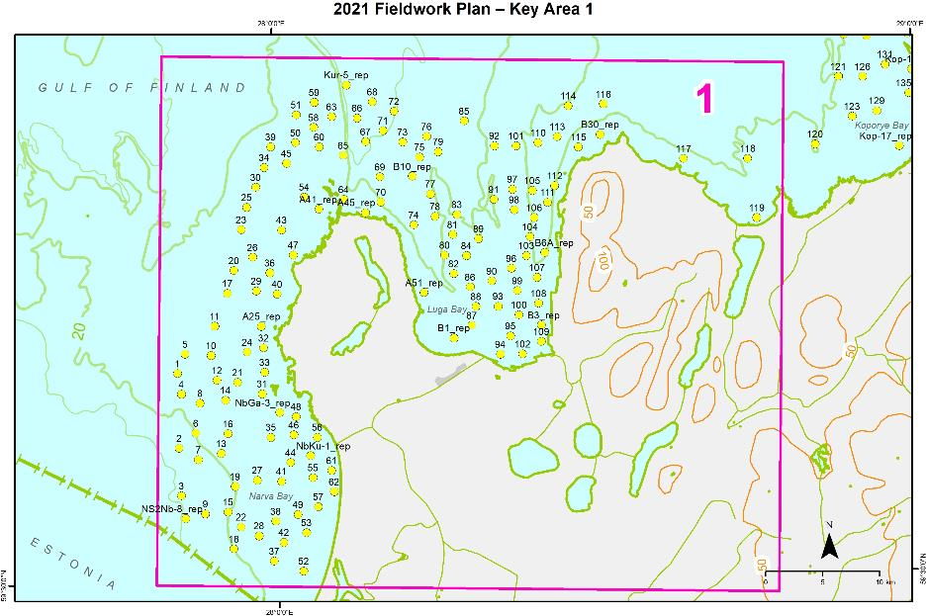
Interannual variability
Repetitive benthos and other biological sampling at selected localities (various habitats and position in gradients) with including sampling of plankton communities
Time of sampling – August-September (settlement of juveniles of byphasic species)
6

Slide 7
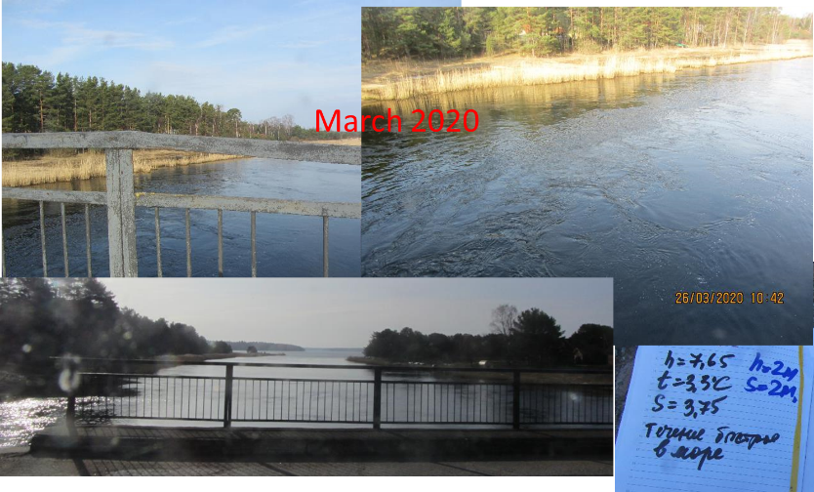
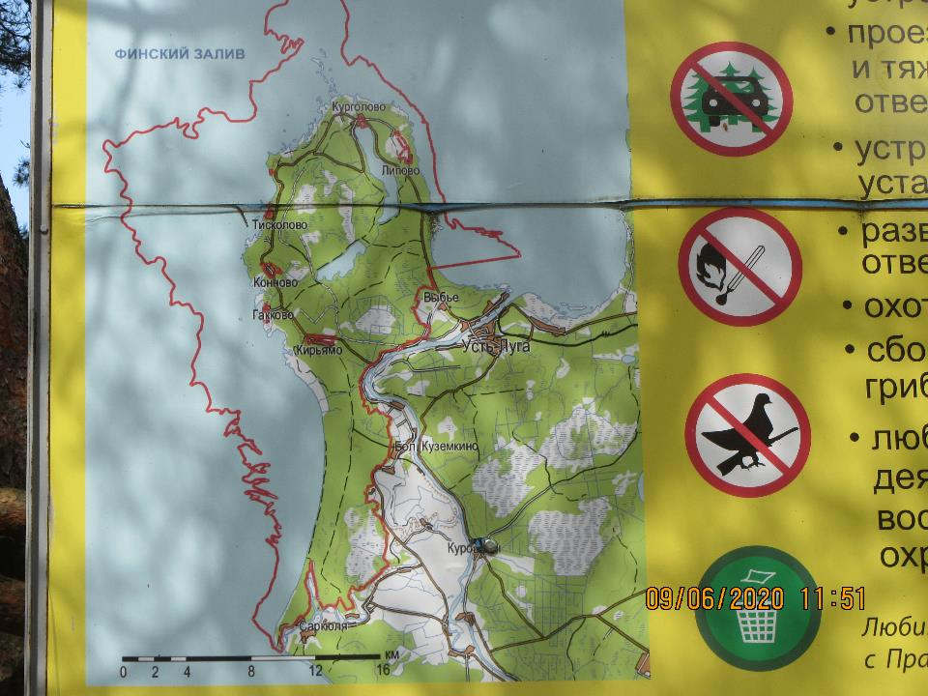
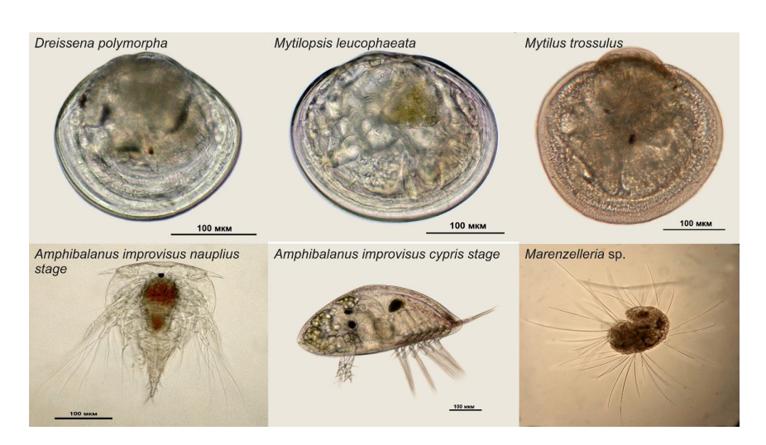
Sampling site established for seasonal observations (March| April-November)on environment conditions and their dynamics and for biological sampling (phytoplankton (microalgae and cyanobacteria) and zooplankton (holoplankton and dispersal stages of key benthic organisms) and macrozoobenthos
7

Slide 8
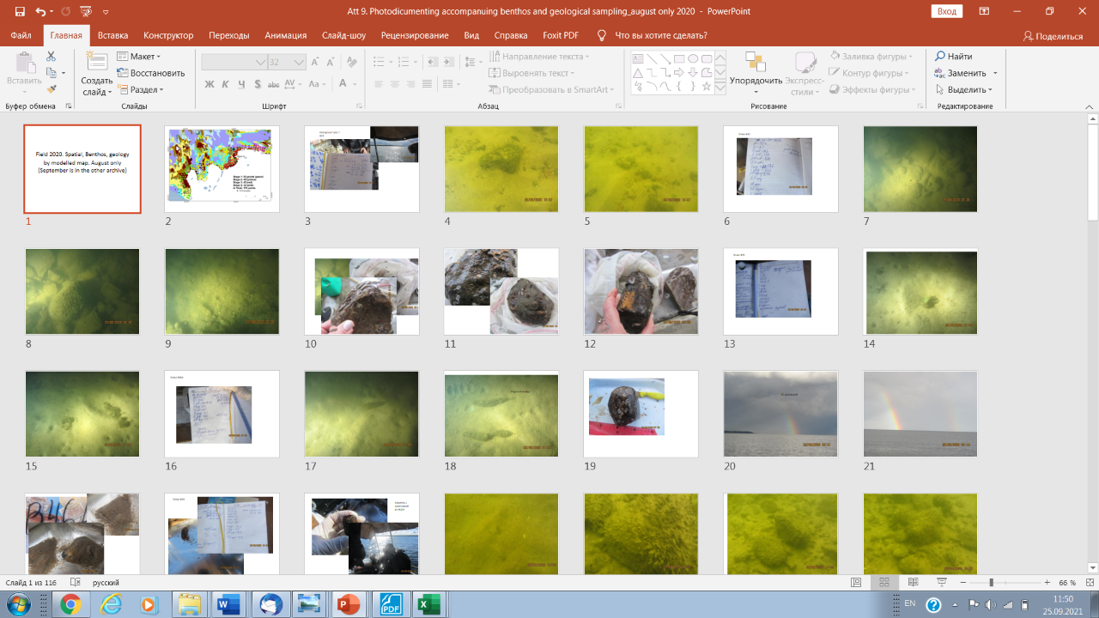
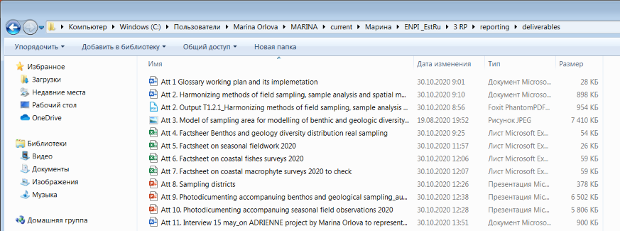
Set of thematic underwater and samples’photos, combined into specific ppt. files with separate sections for each locality (observation point) instead of hundreds of photos for use in RU side of partnership
8

Slide 9
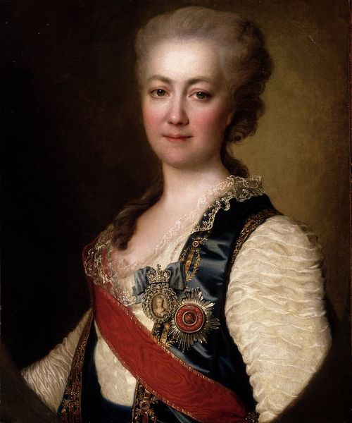
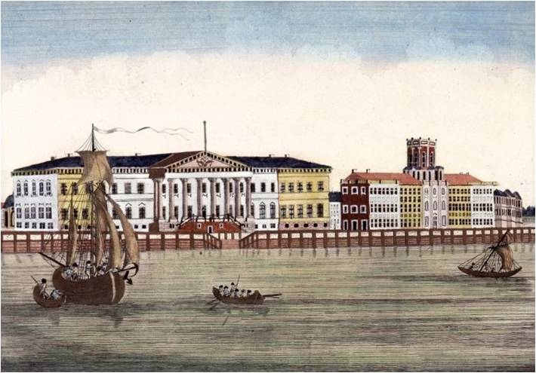
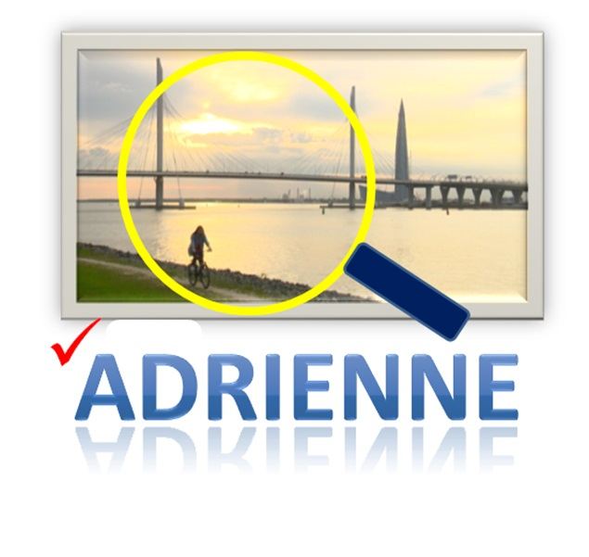
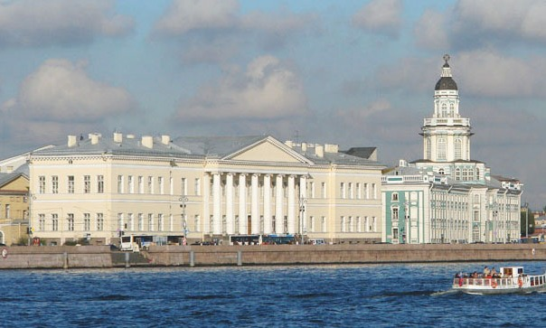
Toward creation of local geo informational space for cultural, scientific and educational communities and common peoples in SPBRC RAS and in the Region (perspective)
Divisions:
HERITAGE|НАСЛЕДИЕ CITY| ГОРОД MAN @ NATURE| ЧЕЛОВЕК И ПРИРОДА
9

Slide 10
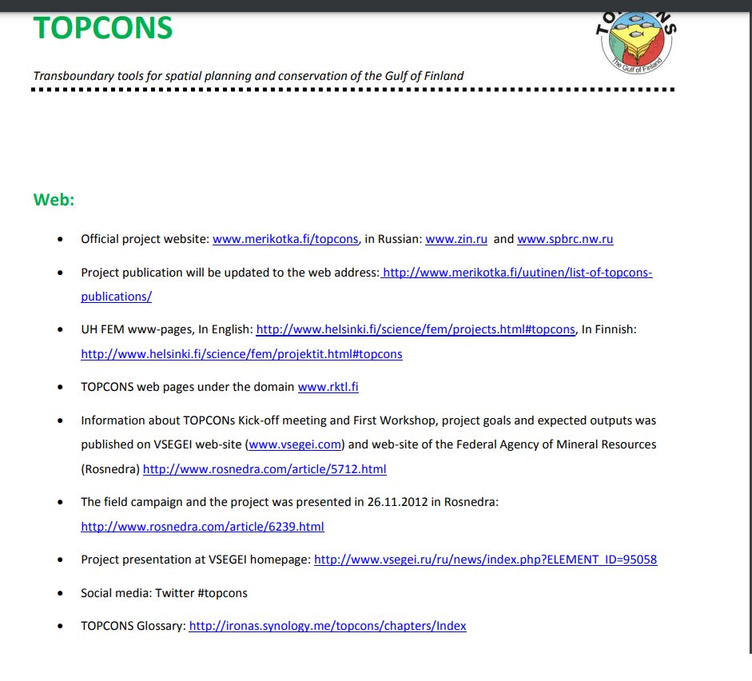
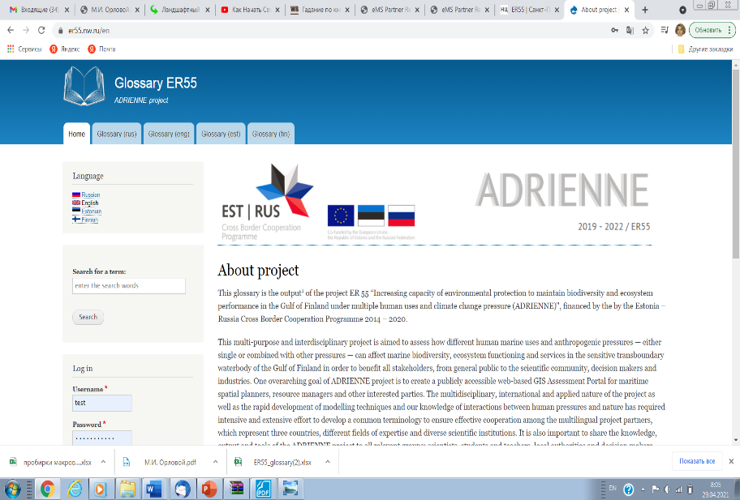
Interactive web deliverables:
10

Slide 11
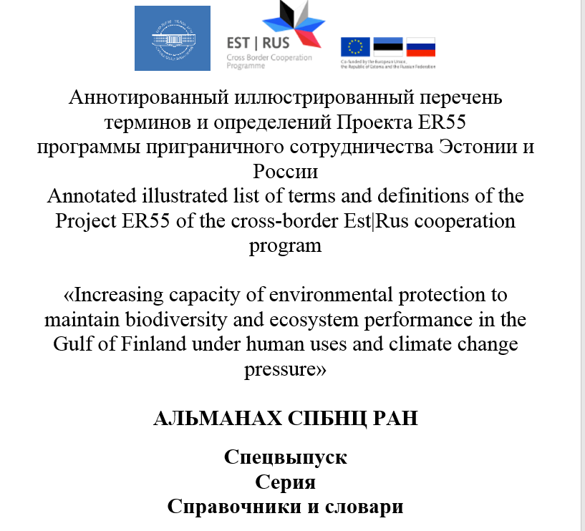
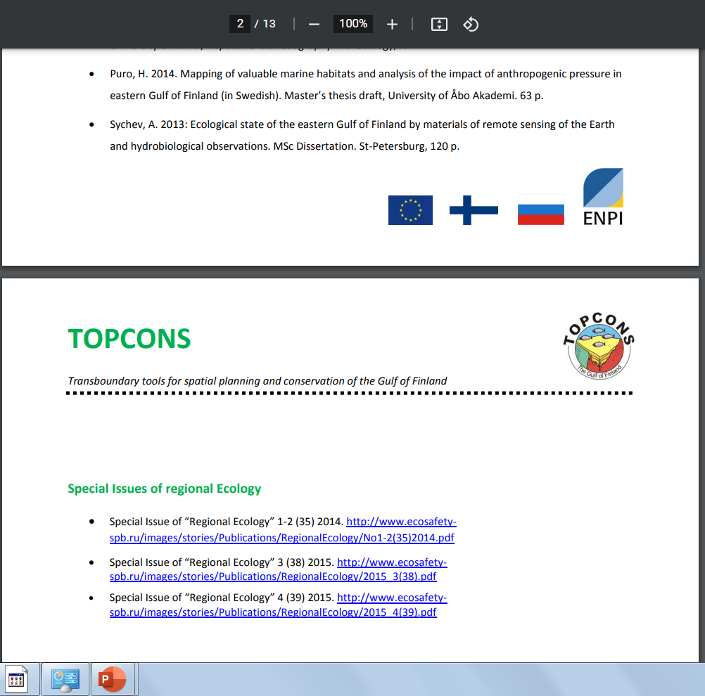
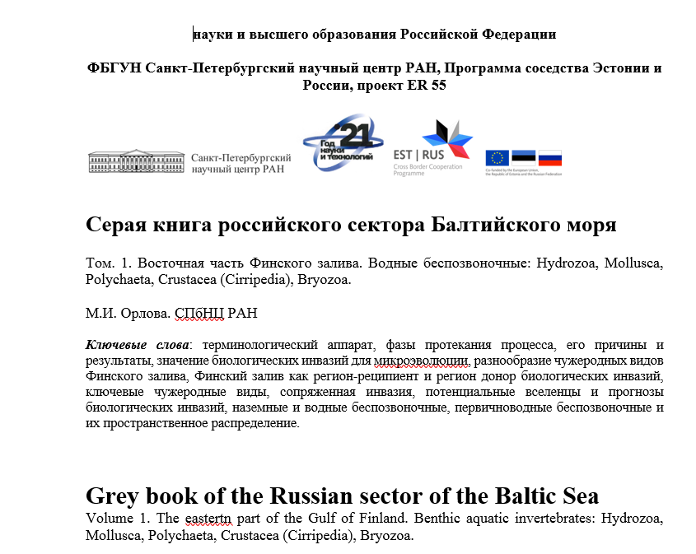
Special issues and monographs:
1.
2.
11
3. Almanac of the SPbRC RAS. Series “Ecology and natural resources” Special issue (V1 № 1)

Slide 12
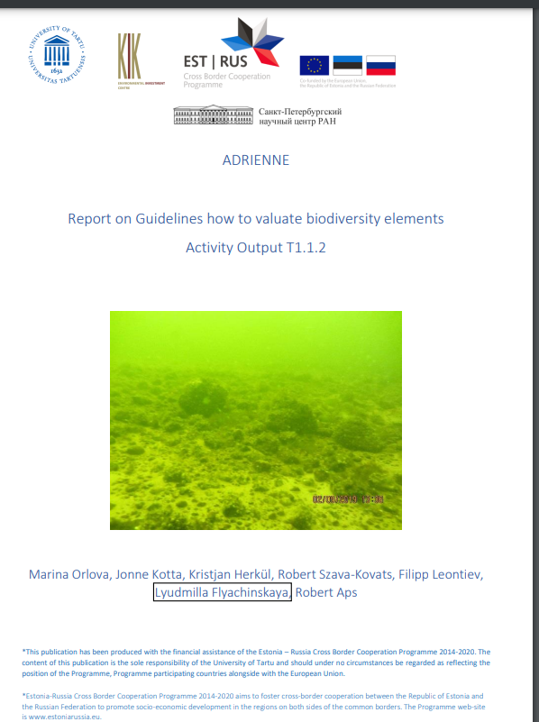
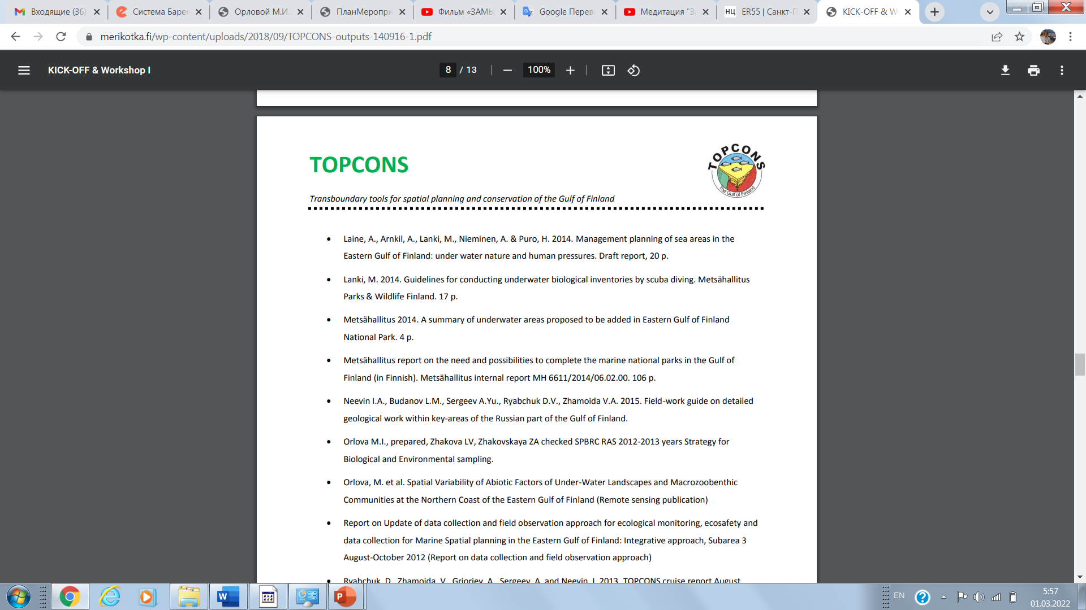
Guidelines and reports:
12

Slide 13
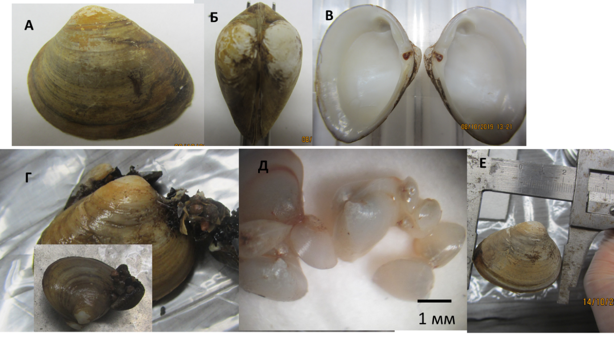
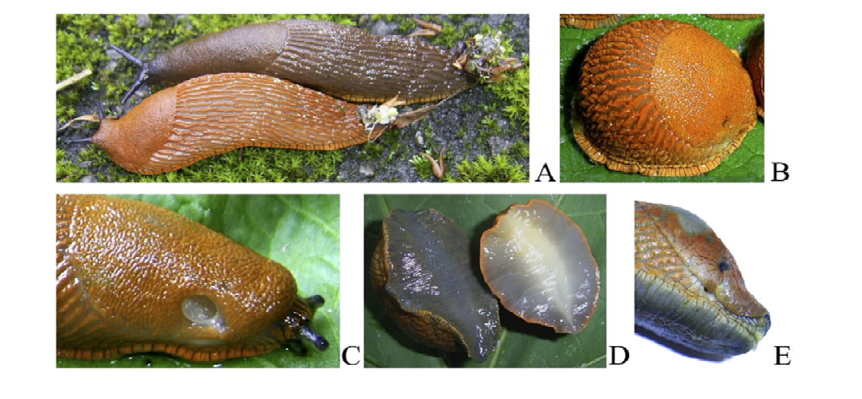
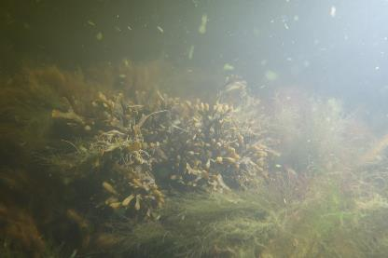
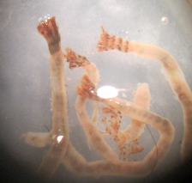
New findings (more details in the other presentation(s)) and in Special issues:
See Elena Ezhova et al., presentation for more details
13

Slide 14
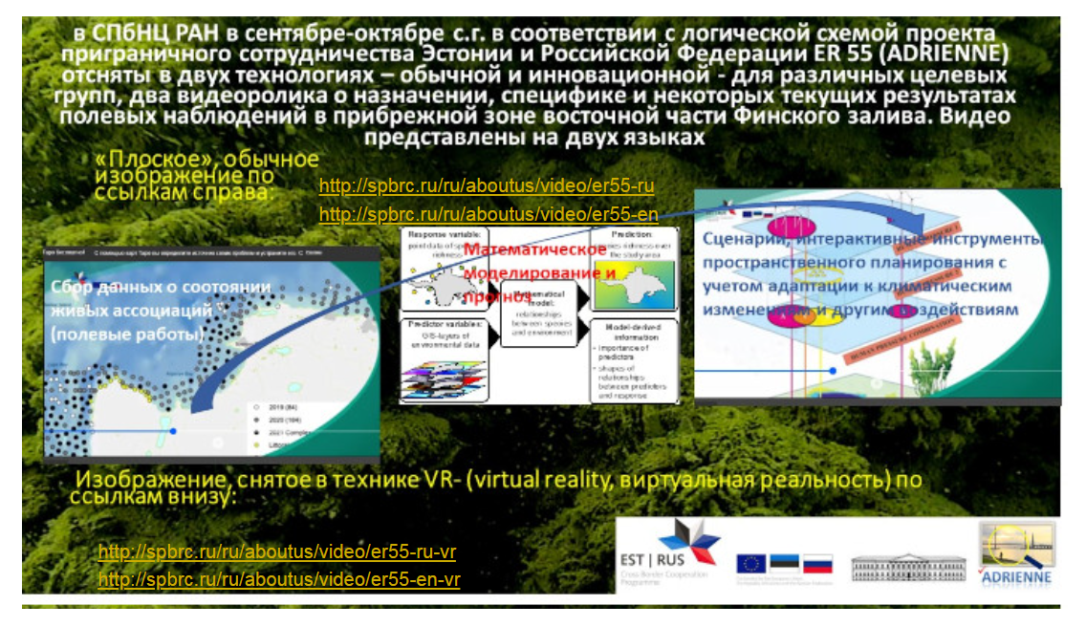
See Ksenia Likhacheva and Valentina Kotelnikova presentation for more details
14

Slide 15
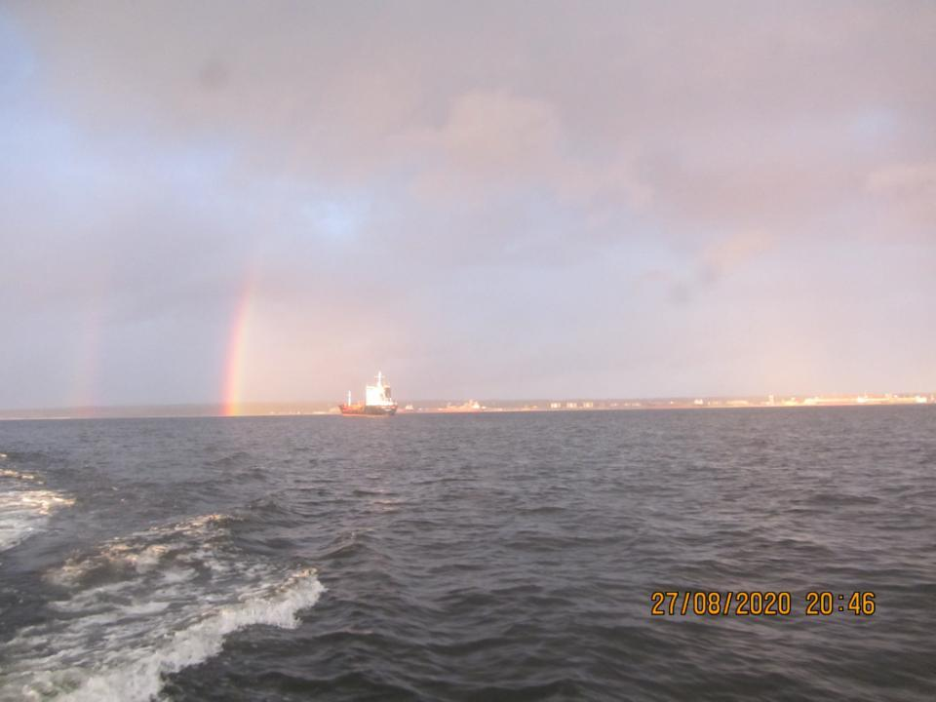
Thank you for your attention!
See also presentation by Mikhail Verevkin

